Slide 1


Slide 2


Slide 3
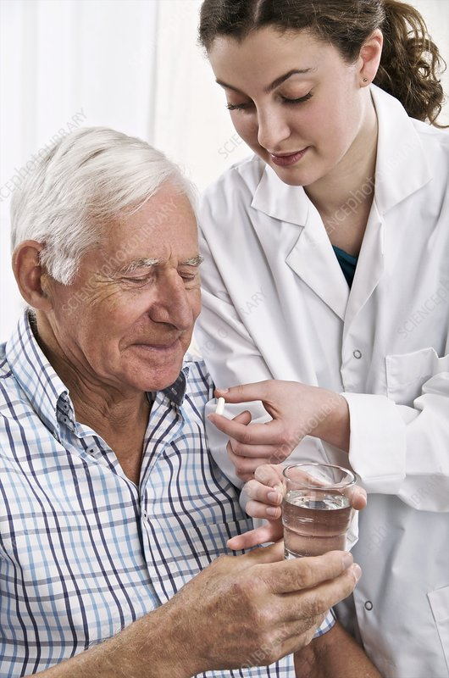
GERIATRIC EMERGENGIES
Prepared by:
Bandana Tiwari
Roll no : 6
BNS 2nd year

Slide 4
UNIT- 7 GERIATRIC EMERGENCIES
CHEST PAIN
SYNCOPE
GASTRO INTESTINAL BLEEDING
HYPOTHERMIA
CEREBROVASCULAR ACCIDENT (STROKE)
INFECTION

Slide 5
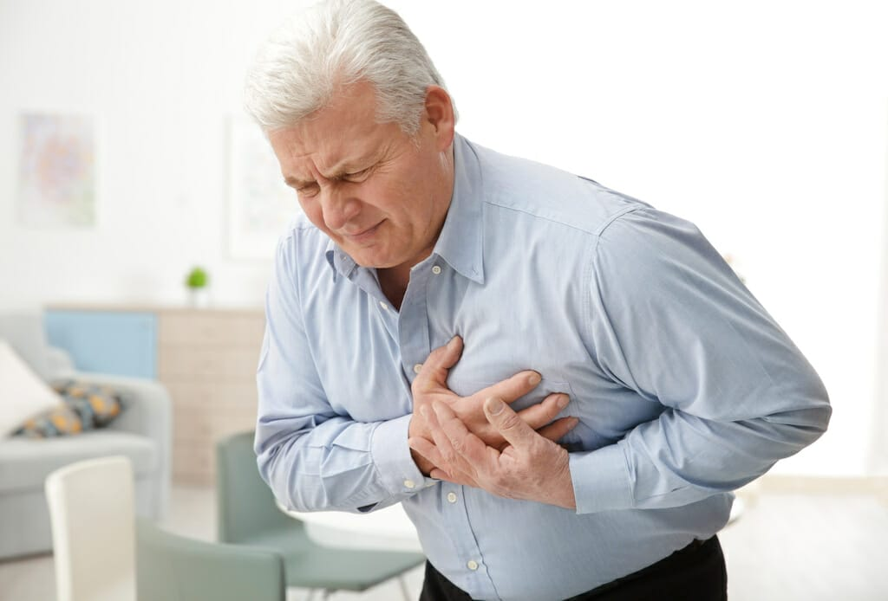
1. CHEST PAIN

Slide 6
INTRODUCTION
Chest pain is a common symptoms that may be caused by number of cardiac and non cardiac problems.
Acute chest pain is a major complain quite commonly presented at emergency department.

Slide 7
Cont..
Chest pain comes in many varieties ranging from a sharp stab to dull ache.
Some types of chest pain can be described as crushing or burning .
In certain case, the pain travels up the neck , pierces through the back or radiates down one or both arms.

Slide 8
CAUSES
CADIAC CAUSE :
Ischemic cause
Angina
Myocardial infraction
Coronary vasospasm

Slide 9
Cont..
b) Non- ischemic cause
Aortic dissection
Pericarditis

Slide 10
Cont..
2) NON- CARDIAC CAUSE:
Peptic ulcer disease
Pneumothorax
Rib fracture
Pulmonary embolism

Slide 11
SIGNS AND SYMPTOMS
HEART RELATED CHEST PAIN:
Pressure fullness or tightness in chest
Crushing pain radiates to back , neck , jaw , shoulder and arms- particularly left arm

Slide 12
Cont..
c. Shortness of breath
d. Pain lasts more than a few minutes, goes away and come back or varies in intensity.
e. Dizziness or nausea

Slide 13
Cont..
OTHER TYPES OF CHEST PAIN
Trouble swallowing
Tender chest
Pain when breathing deeply or coughing

Slide 14
DIAGNOSTIC INVESTIGATION
History taking
Physical examination
Blood test
ECG
X-ray
CT - scan

Slide 15
TREATMENT
MEDICATIONS :
Nitroglycerine
Streptokinase
Anticoagulants like heparin and warfarin
Antacid
Anti anxiety

Slide 16
Cont..
SURGICAL MANAGEMENT:
Balloon and stents
Bypass surgery
Lung re-inflation
Dissection and repair

Slide 17
NURSING MANAGEMENT
Asses the patient condition regard to time, duration and factors that precipitate the symptoms .
A complete and precise physical assessment is critical to detect complication and any change in patient status.
Monitoring vital signs and perform 12 lead ECG.
Oxygen is administered along with medication therapy to assist with relief of symptoms .

Slide 18
Cont..
5. Physical rest in bed with backrest elevated or in supportive chair that decrease chest discomfort and dyspnea.
6. Monitoring fluid volume status to prevent overloading the heart and lungs.
7.Encourage the patient to breath deeply and change position frequently to help keep fluid from pooling in the base of the lungs.

Slide 19
Cont…
8. The limitation on mobility until the patient is pain free and hemodyanamically stable.
9) Alleviating anxiety and decrease fear are important nursing functions that reduce the sympathetic stress response.
10)Provide quite and calm environment.
11)Providing information to patient and family in an honest and supportive manner .

Slide 20
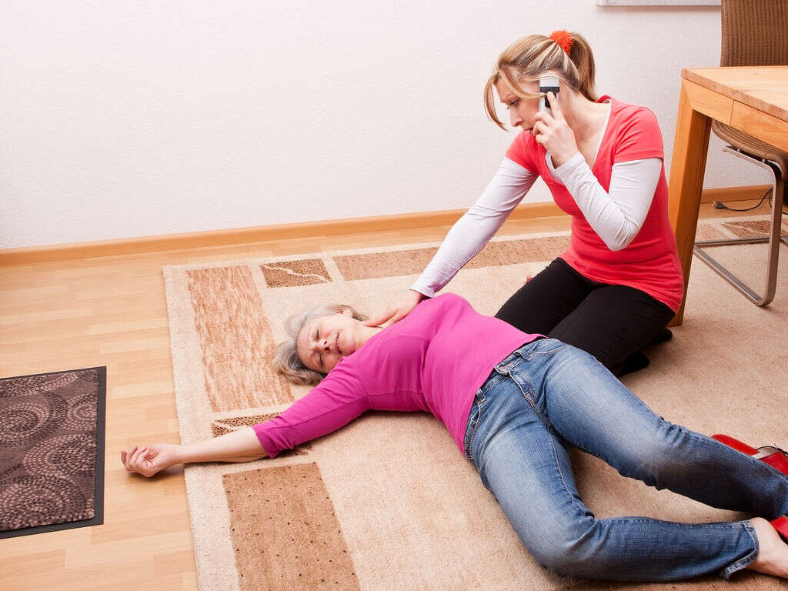

Slide 21
SYNCOPE
Transient and sudden loss of consciousness with a loss of postural tone.
It is also known fainting, black out or syncope is the temporary loss of consciousness .
Syncope is a frequent cause for emergency consultation and hospital admission ; it also an indicator of reduced survival rate among older adults.

Slide 22
Cont..
Among patient older than 65 yrs , admit rate for syncope was 61.8% and was the sixth most common admission diagnosis.

Slide 23
CAUSES
Cardiac disease
Postprandial hypotension
Cerebrovascular , neurological and psychiatric cause
Vasodilators
Antihypertension

Slide 24
Cont..
6. Anemia
7. Dehydration

Slide 25
SIGNS AND SYMPTOMS
Feeling of light headache , nausea , sweaty or week
Feeling of dizziness or vertigo
Vision may fade or blur
Muffled hearing and tingling sensation in the body

Slide 26
DIAGNOSTIC INVESTIGATION
History taking
Physical examination
Electrocardiogram
Complete blood count

Slide 27
Cont..
Thyroid function test
Holter monitoring
CT- scan , MRI
Kidney function test

Slide 28
TREATMENT
Antiarrhythmic drug
Beta blocker
Anaphylaxis

Slide 29
NURSING MANAGEMENT
Assess the patient general condition.
Pulses are checked immediately . If the patient is pulseless, CPR is begun and cardiac resuscitation is done.
If the pulse are present , severe bradycardia is treated with atropine .
Placing the patient in horizontal position with leg elevated typically end the syncope episode if life- threating disorders are ruled out.

Slide 30
Cont..
5. Tension pneumothorax requires insertion of a pleural cannula and drainage.
Administer intravenous fluid.
Administer oxygen and glucose as per need .
8.Provide psychological support to patient and family
9. Provide knowledge regarding disease condition .

Slide 31
PREVENTION
Adequate fluid intake may be enough to prevent dehydration as the cause of syncope.
Patient who have had a vasovagal episode may be aware of warning signs.
Medications may be adjusted if they are thought to be potential cause of fainting or syncope.

Slide 32


Slide 33
INFECTION
Infection is the invasion of an organisms body tissues by disease causing agents, their multiplication, and the reaction of host tissue to these organisms and the toxins they produce.
Infection are more frequent cause of hospitalization on the other hand is a risk factors for life – threatening nosocomial infections, caused by invasive diagnostic procedure and frequent use of urinary catheter.

Slide 34
RISK FACTORS
Impaired immune function
Anatomical and functional change
Environmental factors
4. Polypharmacy
5. Invasive device

Slide 35
COMMON INFECTIONS IN ELDERLY
Urinary tract infection
Pneumonia
Skin infection
Influenza
Gastrointestinal infection
Bacteremia
Infective endocarditis

Slide 36
SIGN AND SYMPTOMS
Fever
Leukocytosis
Change in mental status
Chills

Slide 37
DIAGNOSTIC INVESTIGATION
History taking
Physical examination
Blood culture
CBC

Slide 38
TREATMENT
Broad spectrum antibiotic
Treat the symptoms accordingly
Focus on prevention strategies

Slide 39
PREVENTION
The practice and promotion of hand hygiene.
Consistent use of aseptic technique
Cleaning and disinfection practice
Use of standard precaution

Slide 40
Cont..
Patient education
Removal of unnecessary invasive device
Use of safety device such as mask cap, face shield, googles , gloves , boots etc.

Slide 41


Slide 42


Slide 43
ASSIGNMENT
Write short note on:
Chest pain
Syncope
Infection

Slide 44
PLAN FOR NEXT CLASS
We will discuss about gastrointestinal bleeding and hypothermia .

Slide 45
REFERENCES
K.C, T, & Rai, B, (2019). A Textbook of Geriatric Nursing. (3rd ed). Heritage publisher and distributors.
Subbha.K,H & Subedi, P,S,(2019). A Textbook of Geriatric Nursing. (1st ed). National book centre.
Baral.R, Essential of Geriatric Nursing. Makalu publication.
Pradhan.M,K & Roka, A,T.(2015). Gerontological Nursing for BN/BSN Students. (1st ed) Vidyarthi publication.
Timalsina,R, (2020). Comprehensive Textbook of geriatric Nursing (3rd ed). Samiksha publication.

Slide 46


